Slide 1



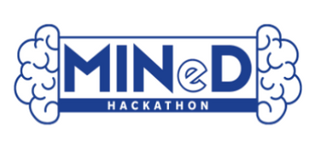
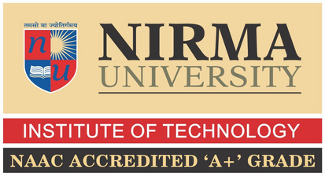

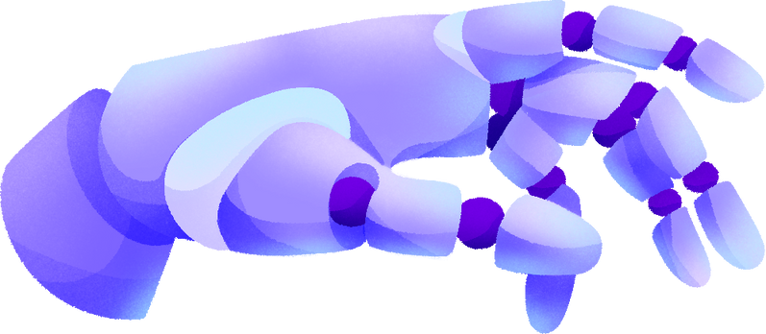
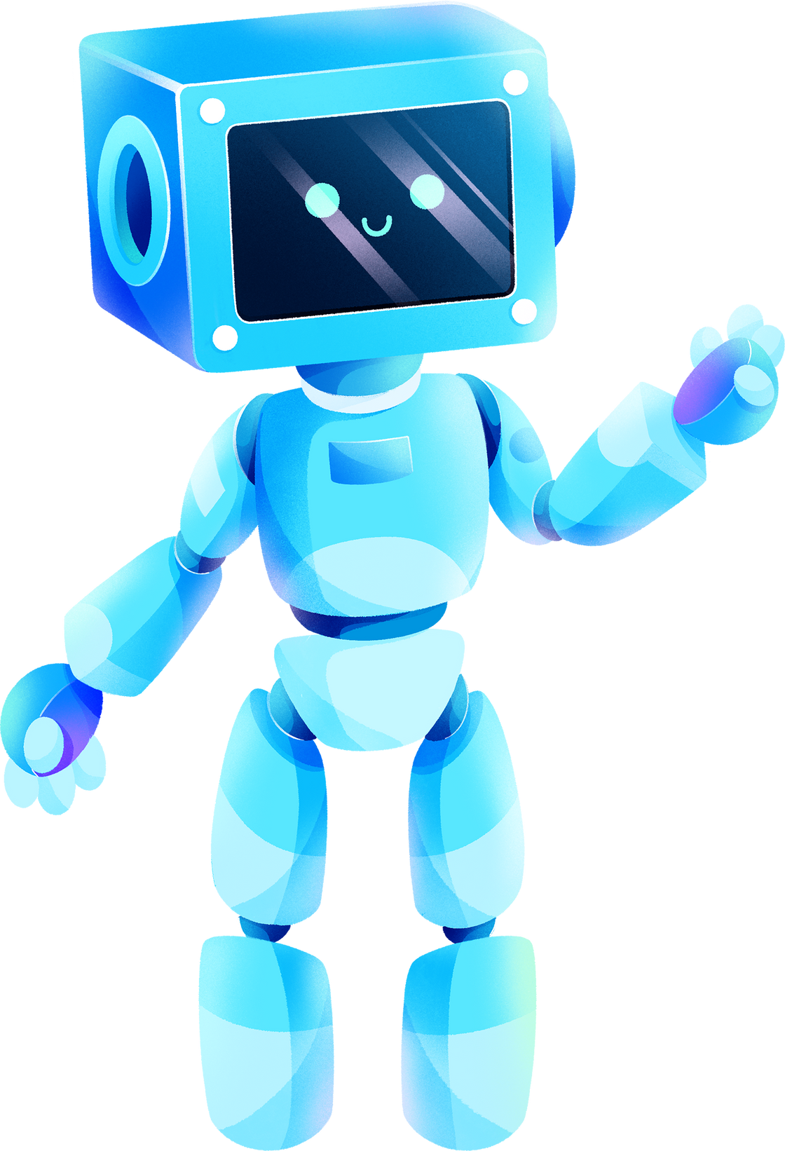
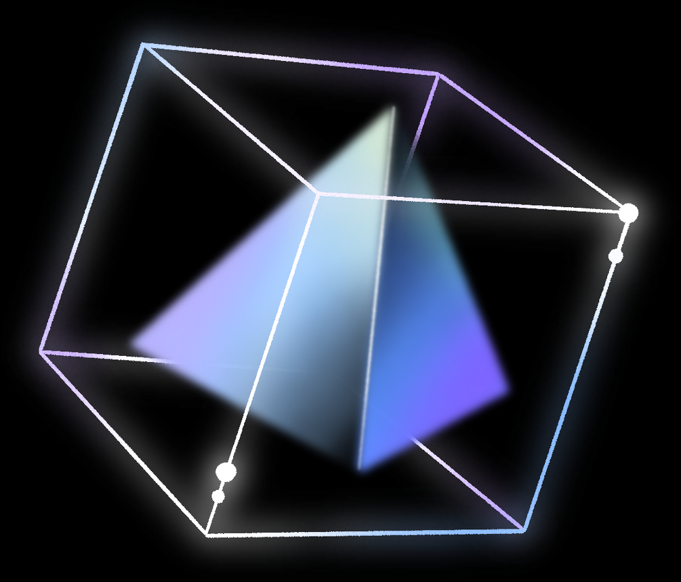
Track 1 : Cactus Communications
CHAT WITH ANY SCIENTIFIC DOCUMENT
Done by:
Manav Pandya
Mohit Jethwani
Ekta Kalavadiya
Parth Mori
Karteekkumar Kalani

Slide 2
TABLE OF CONTENTS
Introduction
Problem Statement
Project Objective
Project Flow
Methodology
Results
Conclusion
01
02
03
04
05
06
07

Slide 3

INTRODUCTION
In the digital age, the vast troves of information stored in various document formats present both opportunities and challenges for users seeking knowledge. To address this, the Document-Based Query Answering System emerges as a sophisticated solution, harnessing the power of cutting-edge technology to streamline information retrieval and analysis. Leveraging the Gemini API from Google's Generative AI platform, this system empowers users to pose queries and receive accurate responses drawn from a diverse range of document types. With a focus on user-friendliness and efficiency, this system represents a pivotal advancement in the realm of document analysis and knowledge extraction.

Slide 4
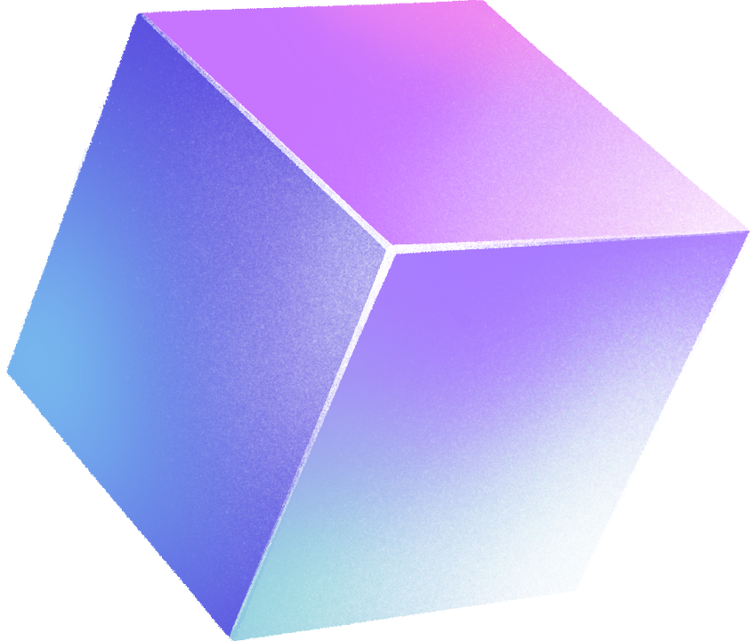
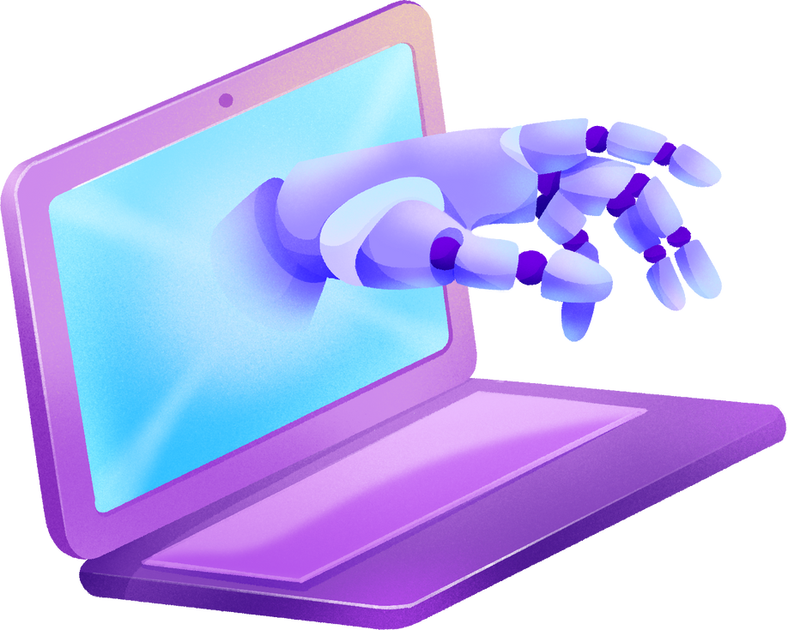
PROBLEM STATEMENT
Despite the abundance of information available in various document formats, users often encounter challenges in efficiently accessing and extracting relevant insights from these sources. Traditional methods of document analysis and query answering lack the sophistication needed to handle the diversity and complexity of document types effectively. As a result, users face obstacles in obtaining accurate and timely answers to their queries, leading to inefficiencies in research, decision-making, and knowledge dissemination. Addressing these challenges requires a comprehensive solution that leverages advanced technologies to streamline document analysis and query answering across diverse formats, ensuring users can access the information they need with ease and accuracy.

Slide 5







PROJECT OBJECTIVES
OBJECTIVE 01
OBJECTIVE 02
OBJECTIVE 03
Versatile Input Handling: Our solution will support a diverse range of document formats, including PDF, .docx, LaTeX (.tex), and .ppt, ensuring compatibility with the varied preferences of researchers and scientists.
Integration with Leading LLMs: By seamlessly connecting parsed documents to renowned LLMs such as GPT, Llama, Mistral, or Claude, users can leverage state-of-the-art natural language processing capabilities to extract insights and generate responses related to the uploaded content.
Interactive Chat Interface: Incorporating a user-friendly chat interface will enable seamless communication with the LLM, allowing users to ask questions and receive accurate responses directly within the platform, enhancing the overall user experience and facilitating efficient knowledge extraction from the documents.

Slide 6
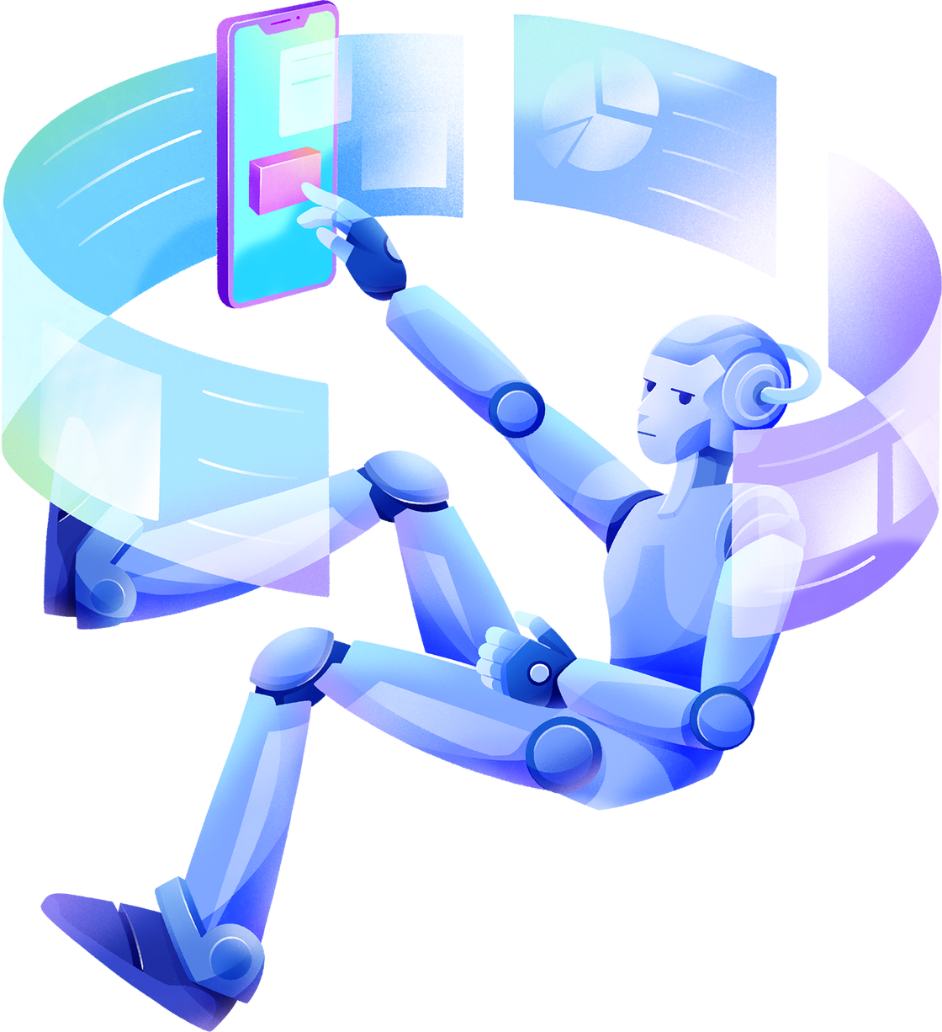

PROJECT
FLOW

Slide 7





DOCUMENT PARSING, ANALYSIS, AND QUERY PROCESSING
USER INTERFACE DESIGN, PERFORMANCE OPTIMIZATION

Slide 8
Document Parsing, Analysis, and Query Processing:
we Implemented modules for parsing documents (PDF, .docx, LaTeX, .ppt)
we use NLP algorithms for query processing
we use LLM as gemini for accurate response generation.

Slide 9
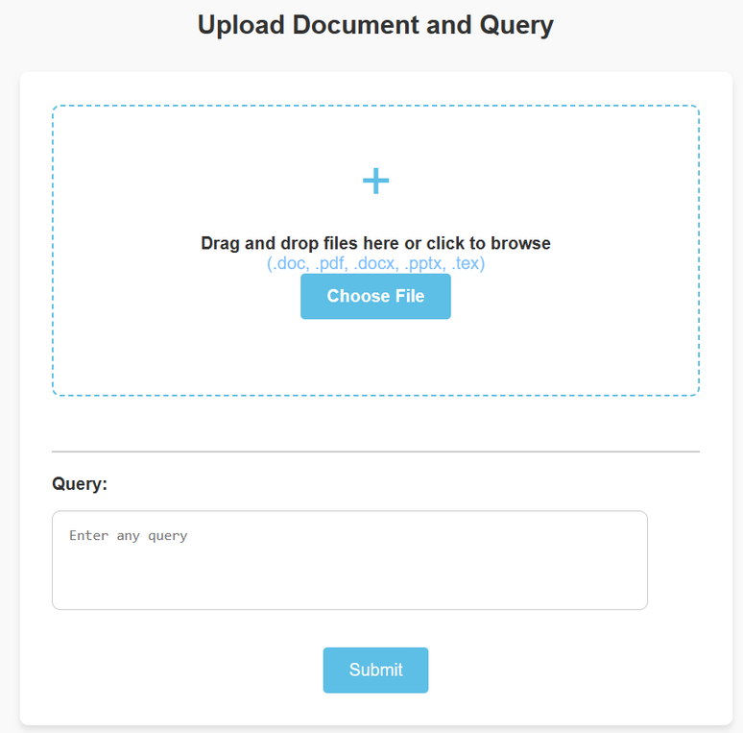
User Interface Design, Performance Optimization
Design user-friendly interface for querying and accessing analysis results.
Optimize system performance and ensure scalability.
Implement security measures and establish maintenance procedures for continuous operation.

Slide 10
Integrating using FLASK Web Framework
In this project we use Flask Web Framework for integrating HTML with Python script.
Why Flask ?
We select Flask for the development of prototypes and proofs of concept because of its simplicity, user-friendly nature, and minimalistic design. Flask allows for quick setup of basic applications, route definitions, and implementation of core features. These qualities make it an ideal framework for rapidly prototyping ideas and experimenting with new concepts.

Slide 11




RESULTS
The Document-Based Query Answering System effectively integrates with the Gemini API, enabling comprehensive document analysis and accurate response generation across various formats, fostering efficient user interaction and knowledge retrieval.
01
Through seamless integration with the Gemini API, the Document-Based Query Answering System empowers users to query and extract insights from diverse document types, ensuring fast response times, scalability, and robust security measures for enhanced reliability and user trust.
02

Slide 12
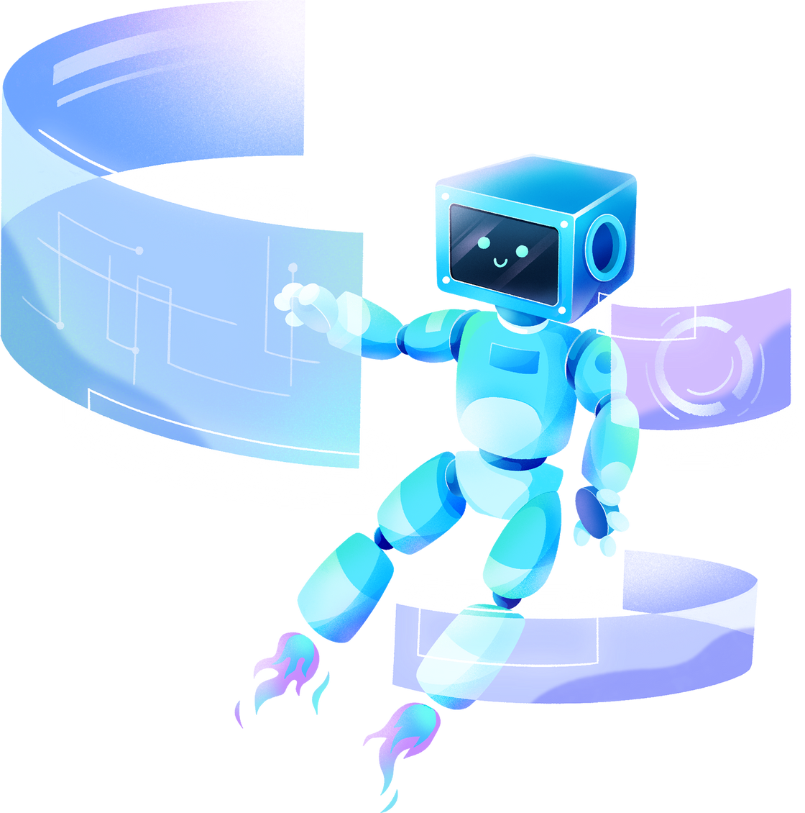
THANK YOU!

